Slide 1
Defending against Malicious Peripherals with Cinch
Sebastian Angel, The University of Texas at Austin and New York University;
Riad S. Wahby, Stanford University;
Max Howald, The Cooper Union and New York University;
Joshua B. Leners, Two Sigma;
Michael Spilo and Zhen Sun, New York University;
Andrew J. Blumberg, The University of Texas at Austin;
Michael Walfish, New York University
25th USENIX Security Symposium
August 10–12, 2016 Austin, TX

Slide 2
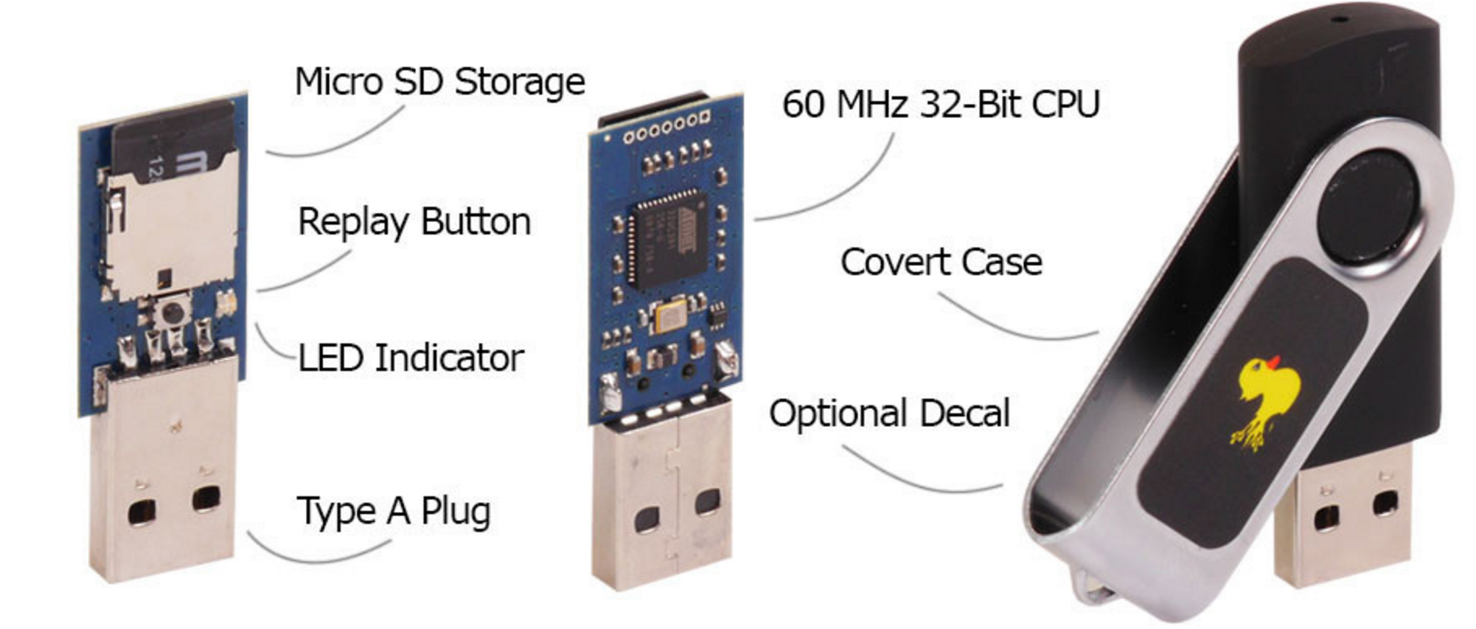
USB Rubber Ducky
A keystroke Injection Tool
The USB Rubber Ducky's scripting language is focused on ease-of use.
It’s Famous amongst hackers, penetration testers and IT professionals.
Only $44.99

Slide 3
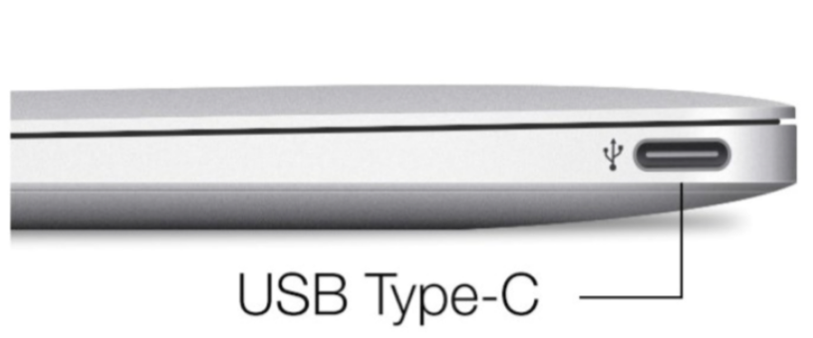
Introduction
Peripheral devices are now powerful, portable, and plentiful.
Commodity machines and operating systems continue to be designed to trust connected peripherals.
There are now many examples of such devices injecting malware by exploiting vulnerabilities in the host’s drivers or system software.
Malicious device can masquerade as a keyboard.
A USB device can eavesdrop on the communication between another device.
Next-generation laptops’ ports, including the power port, are USB.

Slide 4
Introduction
The concepts needed to solve these problems have long been understood.
Applying these works in full requires redesigning the operating system and possibly also the hardware.
Why not arrange for attached peripheral devices on commodity operating systems to appear to the kernel as if they were untrusted network endpoints?
This paper describes the design, implementation, and experimental evaluation of a system called Cinch.

Slide 5
Cinch begins with the following requirements
Cinch should make peripheral buses look “remote,” despite the physical coupling.
Under Cinch, traffic between the “remote” devices and the rest of the computer should travel through a narrow choke point.
Cinch should not require modifying bus standards, motherboards, OSes, or driver stacks.
Cinch should be portable.
Cinch should be flexible and extensible.
Cinch should impose reasonable overhead.

Slide 6
Background: Universal Serial Bus (USB)
Cinch focuses on USB as an initial target.
We make this choice because USB is ubiquitous and complex, and because it has become a popular locus of hardware-based attacks.
However, our approach applies to other buses.

Slide 7
Background: Universal Serial Bus (USB)
USB is a family of specifications for connecting and powering peripheral devices.
Bandwidth ranges from 1.5 Mb/s (USB 1.0) to 10 Gb/s (USB 3.1).
Example devices include storage (e.g., memory sticks), keyboards, sound cards, video cameras, Ethernet adapters, and smart card readers.
USB connections are directed.
On-the-Go allows USB between peers without discarding the directed topology by choosing the host at connection time.

Slide 8
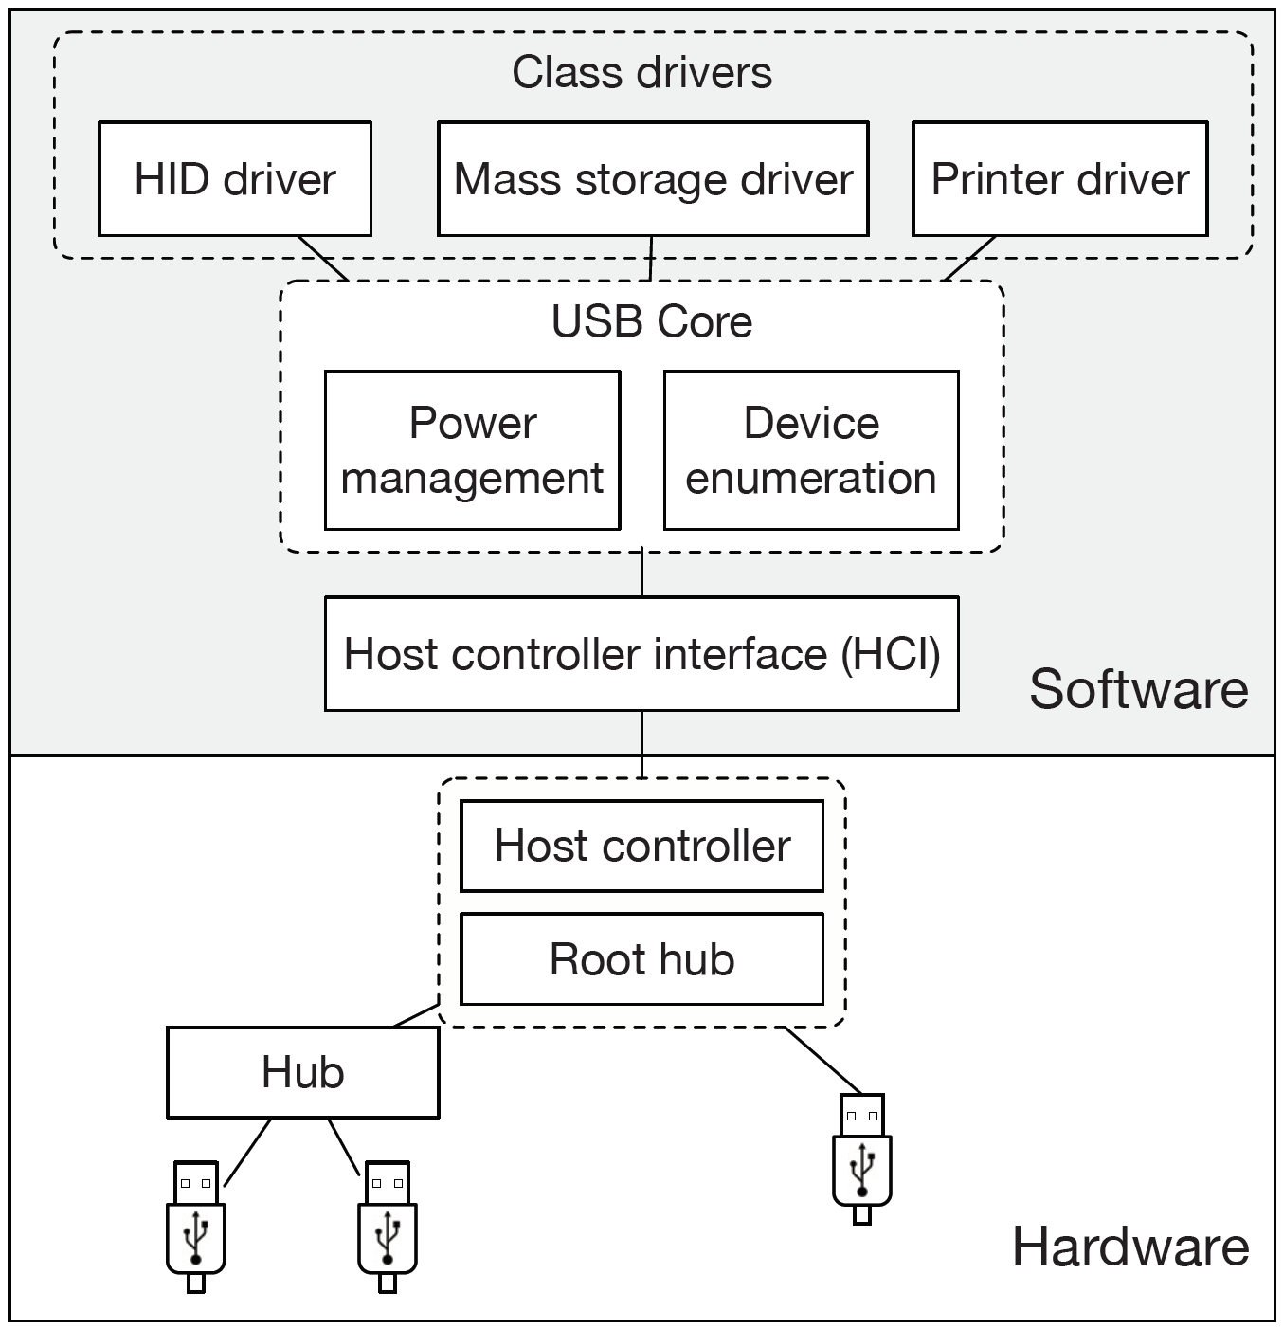
USB hardware:
Tree topology
The root is a host controller(bus master).
Devices are permitted to transmit when polled by the host controller.
Host controller issues interrupts to the host and has direct access to host memory via DMA.
USB protocol:
A protocol stack comprising three layers
Bottom layer includes electrical specifications & a low-level packet protocol.
Middle layer includes addressing, power management.
Top layer includes high-level communication abstractions.
USB devices, comprising one or more functions, sit at the top of the stack.

Slide 9
USB driver architecture:
The host controller interface or HCI, configures and interacts with the host controller hardware via a local bus.
The core manages device addressing and power management, exposes an interface for high-level drivers, identifies devices and activates its driver.
The class drivers interact with devices functions and provide an interface between USB devices and the rest of the OS.
The USB specification defines a set of generic classes which OS generally include support for.

Slide 10
Why is USB so vulnerable?
Neither USB nor mainstream OSes are designed to be robust in the face of malicious devices.(lack of authentication or confidentiality)
The USB protocol and common driver stacks emphasize convenience above correctness and security.(hotplugged)
Creating custom USB devices is now cheap, both in dollars and development time.
Malicious USB devices can easily find their way into the hands of victims.

Slide 11
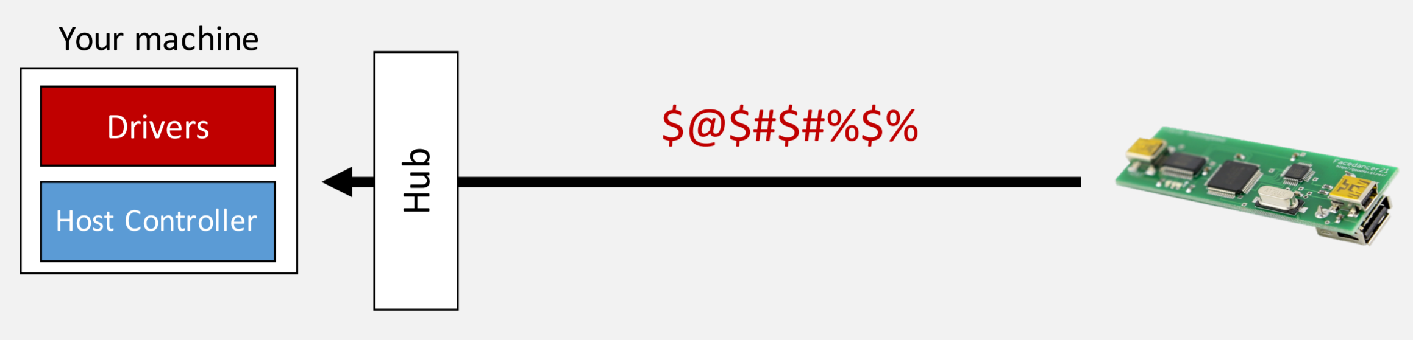
A taxonomy of USB attacks
Peripherals can exploit driver vulnerabilities.

Slide 12
Peripherals can exploit driver vulnerabilities
A driver with an unchecked buffer access might allow a malicious device to overwrite kernel memory via an overflow.
Devices might try to deliver more data to the driver than indicated by the device’s configuration; claim impossible configurations.
The prevalence of these attacks reflects a difficult software engineering situation.
Since a driver writer needs to be prepared for an enormous range of undocumented behavior, drivers need lots of error checking code.
More than half of the vulnerabilities related to USB drivers in the CVE database are the result of improper handling of noncompliant USB transfers.

Slide 13
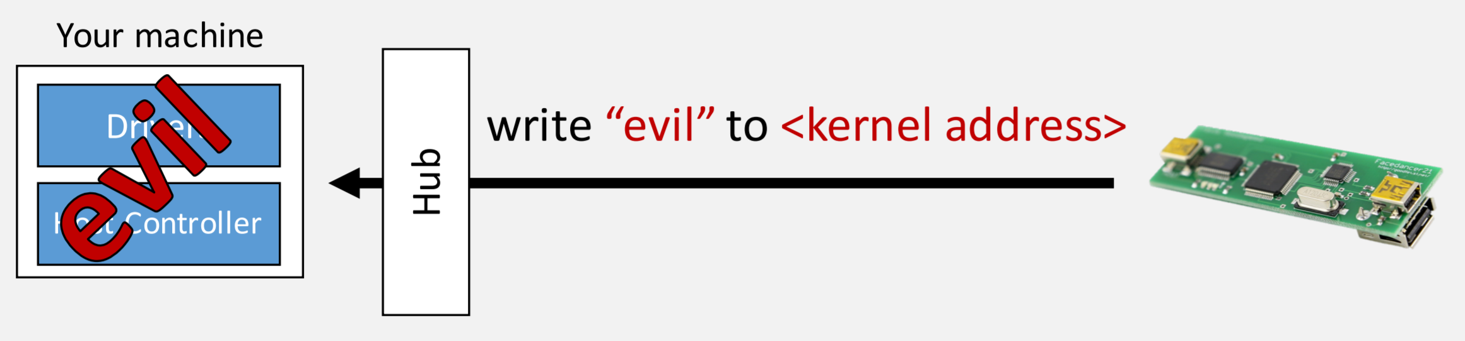
A taxonomy of USB attacks
Peripherals can leverage DMA to attack OSes.

Slide 14
Peripherals can leverage DMA to attack OSes
USB class drivers provide an interface between devices and other kernel subsystems.
A USB flash drive might be used to attack the file system, carry a virus or steal data.
USB host controller uses DMA to bypass the CPU and read or write arbitrarily to RAM.
Misconfigured DMA-capable hardware steals sensitive data, modifies running software or executes arbitrary code.

Slide 15
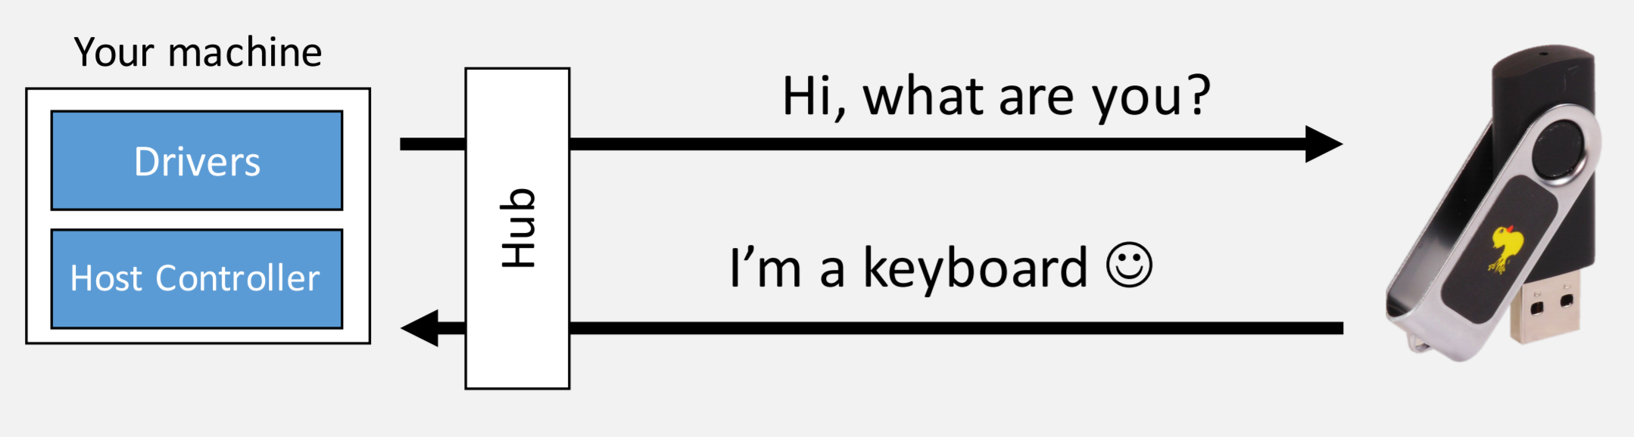
A taxonomy of USB attacks
Peripherals can lie about their identity.

Slide 16
Peripherals can lie about their identity
Device masquerading
When a device is plugged in, the host asks the device for information about its capabilities.
“USB Rubber Ducky” is a programmable keystroke injector in the guise of a flash drive.

Slide 17
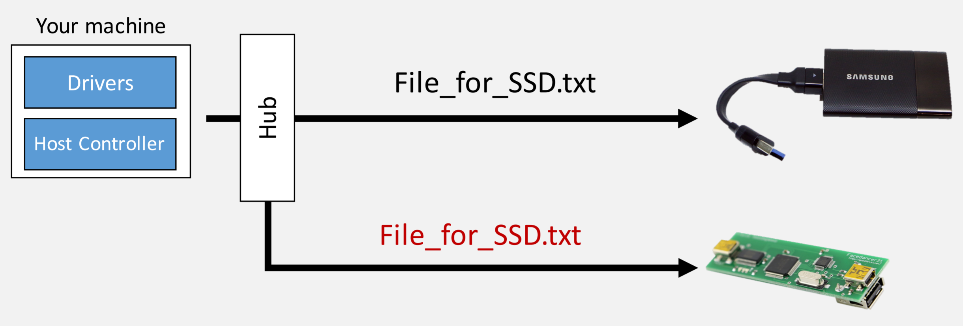
A taxonomy of USB attacks
Hubs broadcast messages downstream.

Slide 18
Hubs broadcast messages downstream
Bus eavesdropping
In USB 2 and earlier versions, hubs broadcast traffic from their upstream port to all downstream ports.
In all protocol versions, malicious hubs can eavesdrop on upstream and downstream traffic. Furthermore, a hub need not be malicious: if its firmware is buggy, it can be exploited by a malicious device.

Slide 19
After having basic knowledge of USB
After knowing problems we encounter

Slide 20
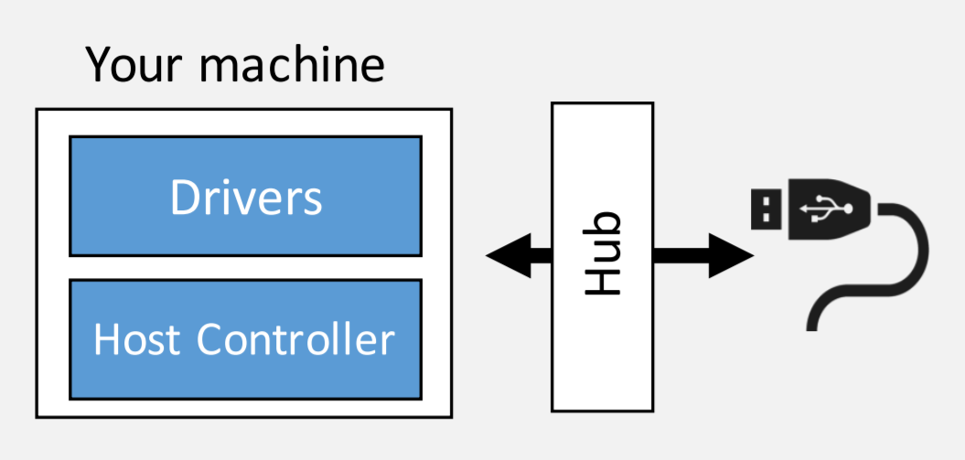
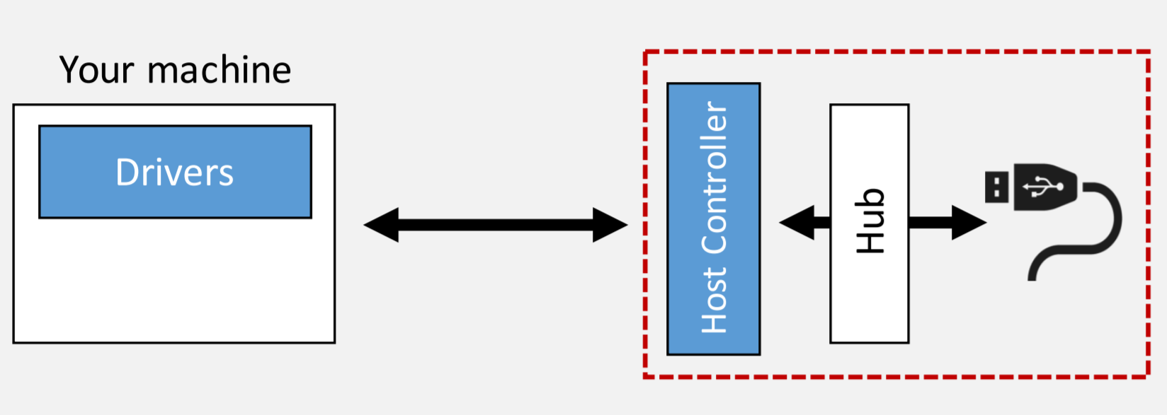
What we have today.
What we want.

Slide 21
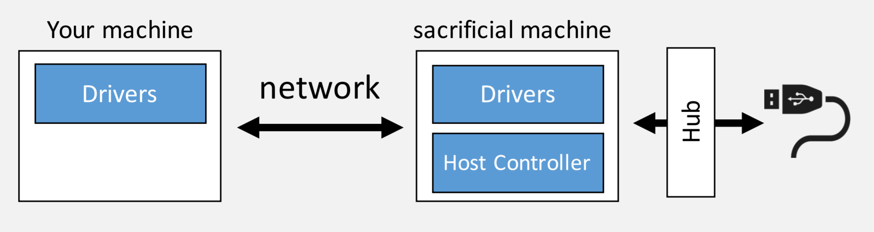
Pragmatic choice: leverage virtualization technology to instantiate the (sacrificial) machine on the same hardware.

Slide 22
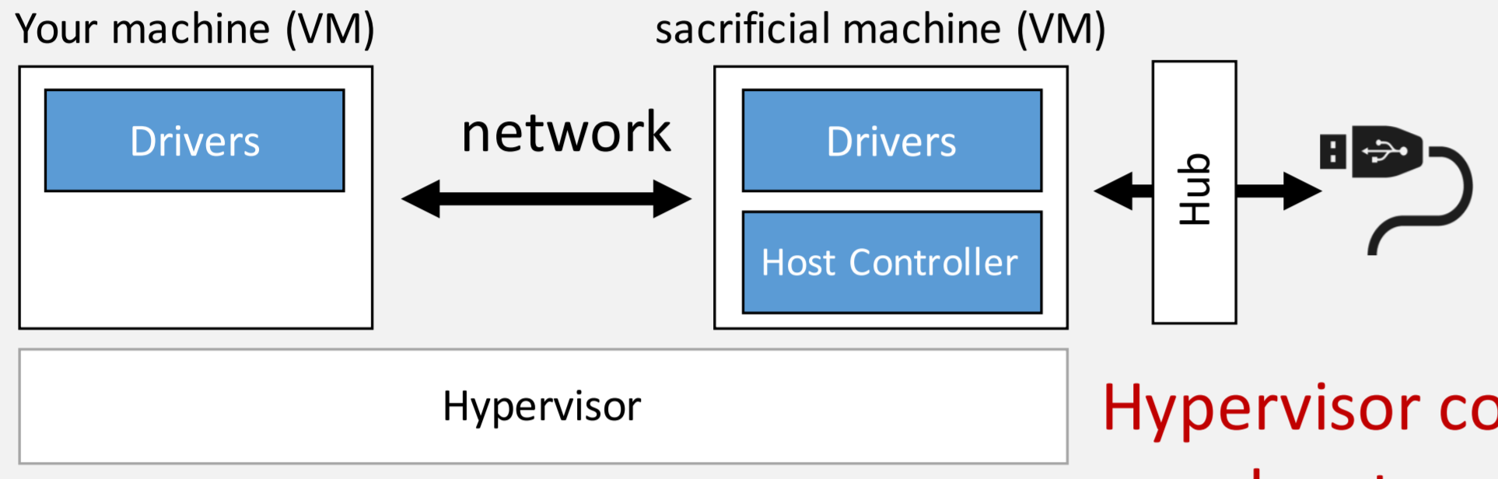

Under Cinch

Slide 23
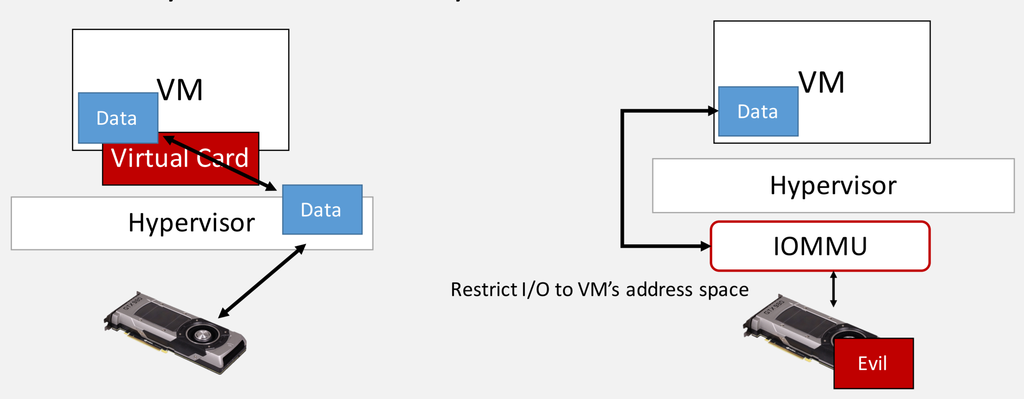
Device can only write to configured addresses

Slide 24
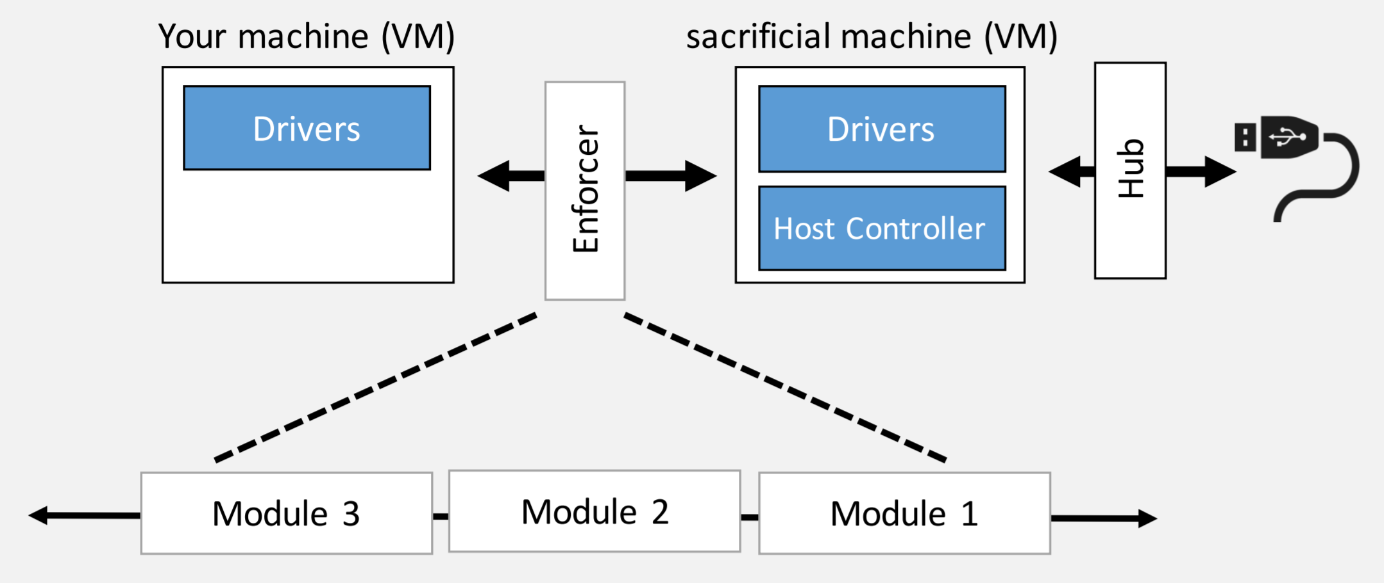

Slide 25
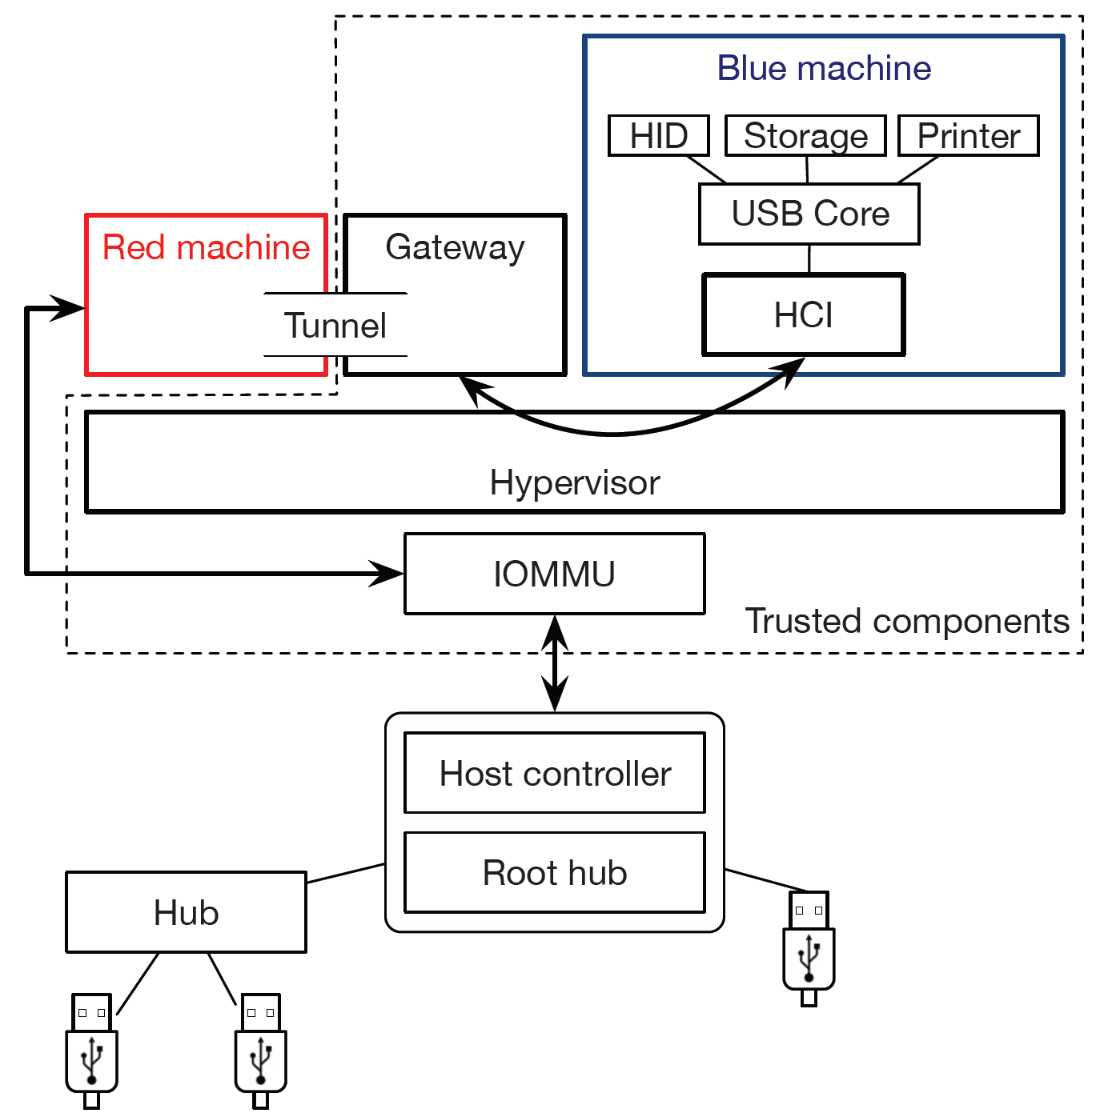
The host controller is dangerous—it issues interrupts and accesses memory via DMA.
The Gateway mediates all transfers through the Tunnel and enforces security policies.
The red machine and blue machine run on top of this hypervisor and are full fledged virtual machine, with normal OS. And the Gateway is a separate process.

Slide 26
Building defenses with Cinch
Detecting attacks by signature
Signature matching is to drop messages that match a known pattern.
Advantages: flexible, shared databases, rapid responses
Disadvantages: suffer from both false positives and false negatives, provide protection only against previously observed attacks

Slide 27
Building defenses with Cinch
Sanitizing inputs
Cinch checks that messages are properly formatted and that devices respond correctly to commands.(Cinch’s compliance Policy)
We manually processed the USB 2 and 3 specifications, along with the specifications of five device classes(mass storage, HID, printer, power, and debug).
The result is a module that monitors device states and transitions.
Cinch modifies device behavior.(Cinch’s assertion Policy)
traffic normalization
Rewriting identification strings
Rewriting device’s requests to work around buggy firmware
Prevents certain types of driver bugs from being exploited.

Slide 28
Building defenses with Cinch
Containing devices
This category includes querying a user for information about a newly connected device, restricting a device to a subset of its functionality, and isolating devices in private protection domains.
Cinch might ask the user, “I see you just connected a keyboard. Is this right?”
User could be informed of available functionality upon device connection, and choose to disallow the device’s storage function as a precaution against viruses.
Cinch’s Gateway can also sandbox whole devices. In this case, the sandbox could scan files for viruses, and could expose a high level interface (e.g., an HTTP or NFS server) to the blue machine.

Slide 29
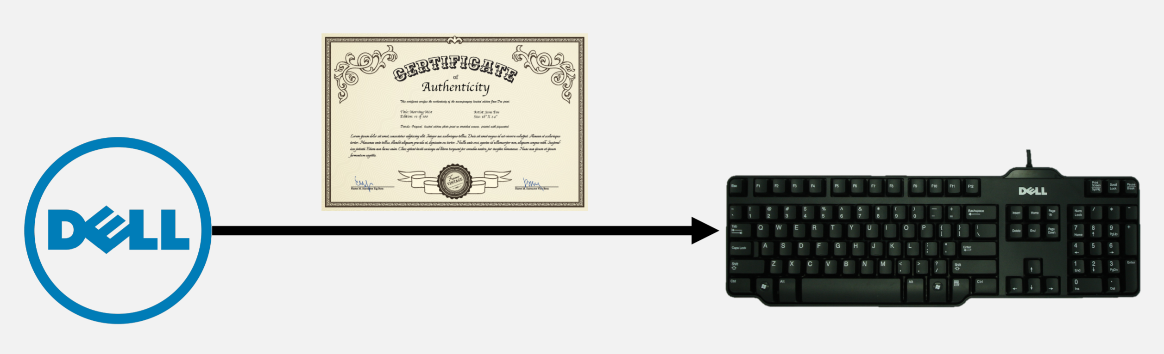
Building defenses with Cinch
Encryption and authentication
Manufactures sign certificates and install them on devices.
After completing a key exchange, the device and host share an encryption key.
The user can then prevent masquerading and eavesdropping.
potential concerns: development overhead to build new devices, computational overhead for cryptography, and deployment on legacy devices
At a high level, the concerns are addressed by, respectively, abundant support for rapid development of embedded cryptographic applications, the speed of modern embedded processors, and a physical adapter that adds cryptographic functionality to legacy devices.

Slide 30
Building defenses with Cinch
Logging and auditing
Auditing logs can reveal anomalous behavior that might indicate a new attack.
Logs can be used to develop new signature-based defenses.

Slide 31
Implementation
Components and communication paths
Hypervisor is Linux running QEMU/KVM
The red machine runs Linux. The blue machine is another VM which can be any OS supported by QEMU.
The Gateway is a Linux user-level process and it is written in Rust.
The Tunnel between the red machine and the Gateway appears to both entities as a network device.
Our implementation uses usbredir, which (on the red machine), captures USB transfers, listens on a network socket, and uses a custom protocol to encapsulate USB transfers inside a TCP stream.
The Gateway’s major modules are parsers for usbredir packets and USB transfers, and a library that provides abstractions for creating new Policies.

Slide 32
Implementation
Components and communication paths
As a usbredir client, the Gateway receives usbredir packets, filters or modifies them.
And then, playing the role of a usbredir server, delivers them to the QEMU process running the blue machine.
A module in QEMU is the corresponding client; it decapsulates the USB transfers(using usbredir) and injects them into a virtual host controller created by QEMU and exposed to the blue machine.

Slide 33
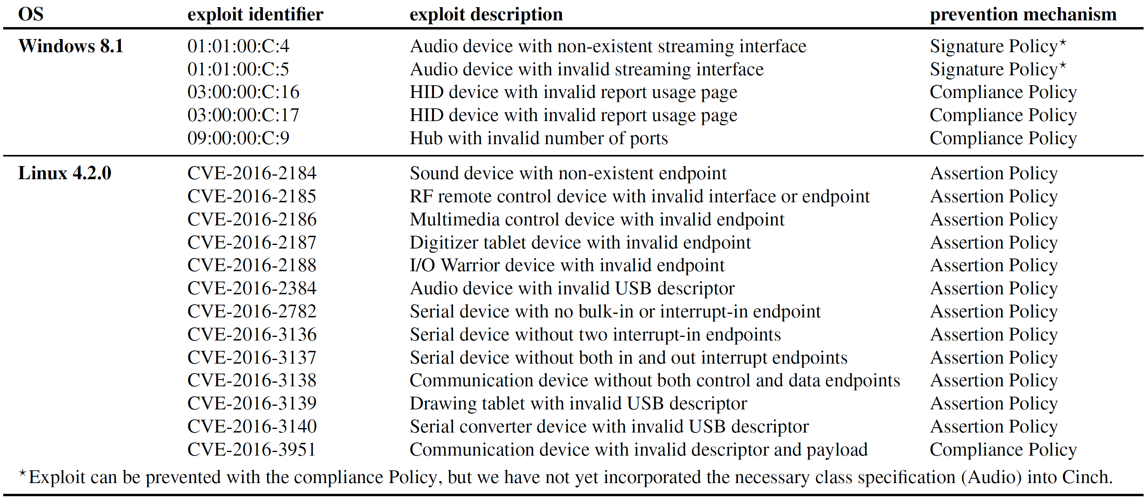
Evaluation-Known signature attacks
We configure Cinch with the signature, assertion, compliance, and logging Policies.

Slide 34
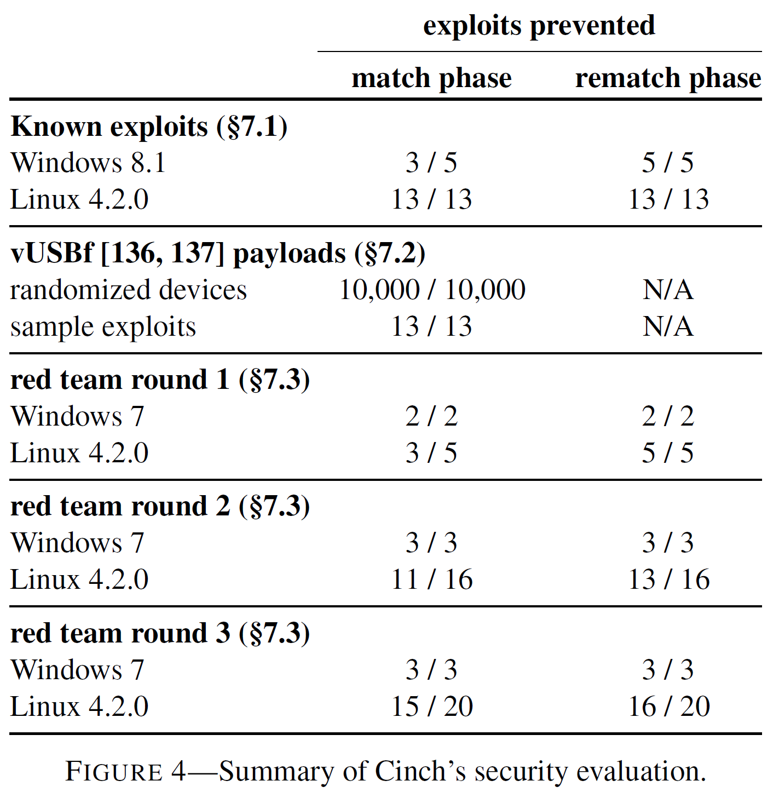

Slide 35
Evaluation-Fuzzing
Device enumeration is a common and well-studied source of vulnerabilities, accounting for about half of all USB related entries in the CVE database.
We use vUSBf, a fuzzing tool that generates a random set of device descriptors and then emulates a device attach event.
We run Cinch, configured with compliance and logging Policies.

Slide 36
Cinch’s compliance module prevents all emulated devices from connecting to the blue machine.
The three most commonly detected violations are: (1) improperly formatted strings, (2) invalid device classes, and (3) invalid or inconsistent number of functions.

Slide 37
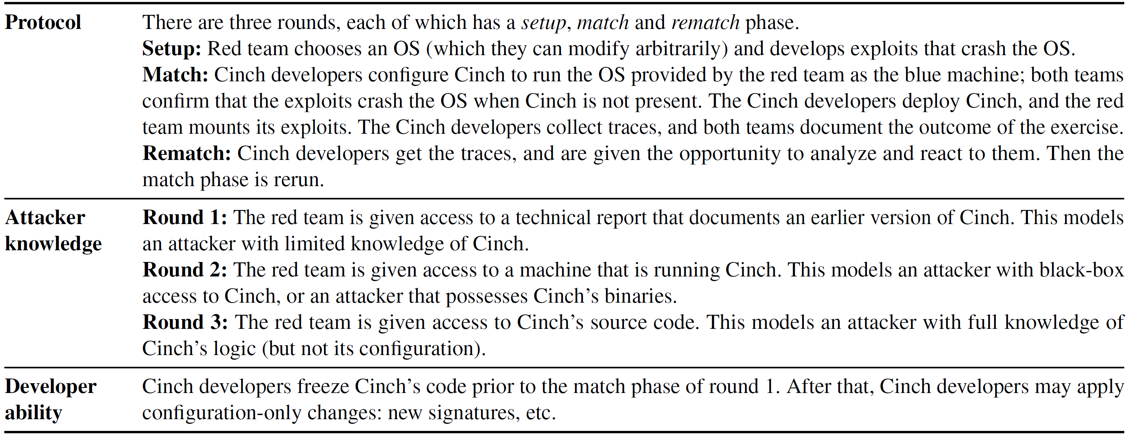
Evaluation-Red team exercise

Slide 38
First round. The red team developed 7 exploits for this round (2 for Windows and 5 for Linux).
Second round. In the match phase, Cinch prevented 14 out of 19 attacks, including attacks from the first round. The remaining three succeeded because they are polymorphic.
Third round. In the match phase, Cinch prevented 18 out of 23 attacks, including attacks from prior rounds for which signatures were available.

Slide 39
Evaluation-Red team exercise
Tradeoff between security and availability
It is possible to develop more aggressive signatures to prevent polymorphic attacks.
However, this risks disabling benign devices.
To ensure that our signatures did not cause such false positives, we established a representative set of benign devices: a USB flash drive, printer, phone, SSD, keyboard, and mouse.
After each phase of the experiment, we checked that our signatures did not keep these devices from working.

Slide 40
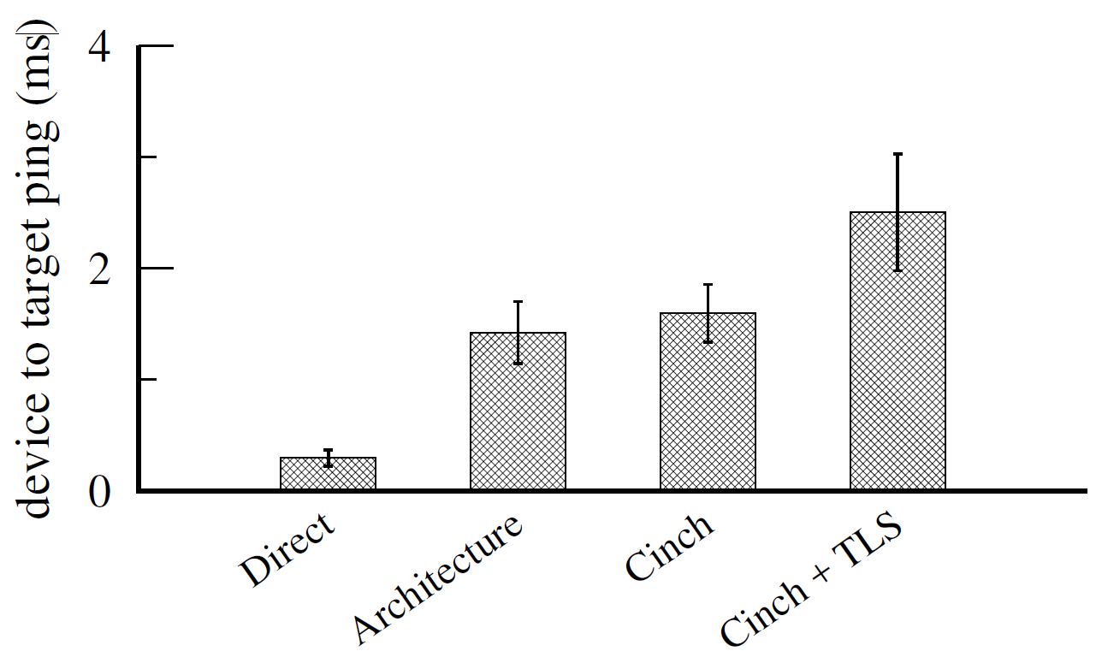
Is Cinch’s added latency acceptable?
resulting in a round-trip time of less than 2.5 ms.

Slide 41
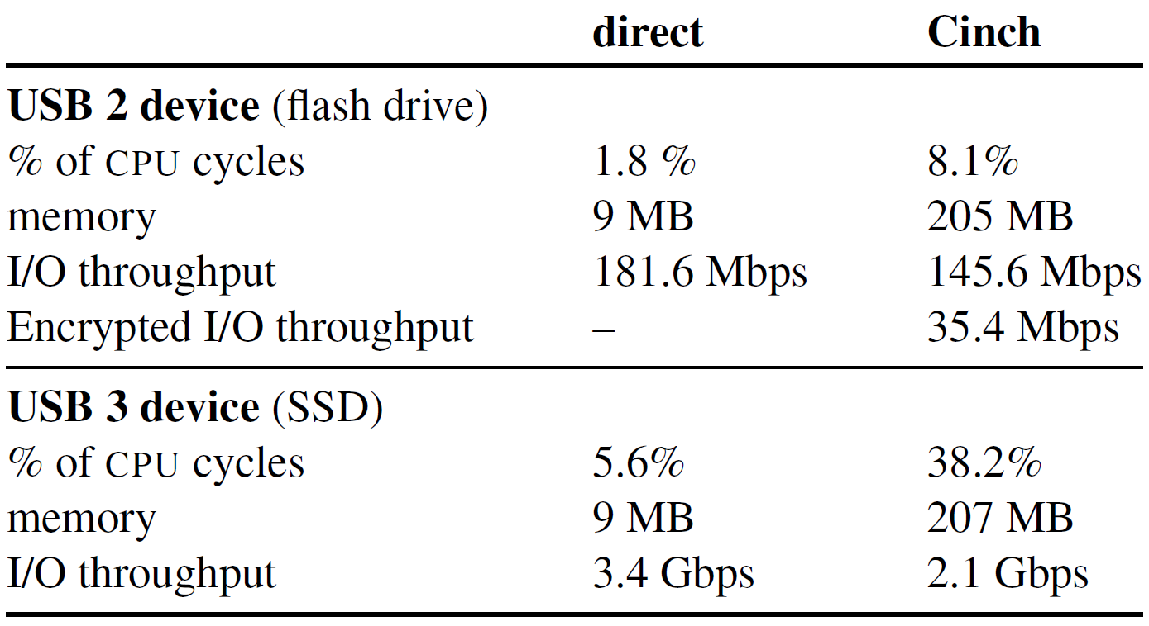
Cinch’s impact on throughput
in line with the cost of other security applications(antivirus).

Slide 42
Summary of Evaluation
Weak against polymorphic attacks on vulnerable drivers.
we have likely not explored the full attack space.
Cinch might not meet stringent latency requirements.
Cinch brings network defenses to USB, but it also inherit their limitation.

Slide 43
Conclusion
commodity operating systems have relatively few safeguards against misbehaving hardware, reflecting a time when peripheral devices could be trusted.
With the rapid decline in the barriers to producing plug and play peripherals, those days have come to an end.
Cinch’s enforcer is modular and defenses are natural and easy to implement.
Cinch is not perfect, but eliminates some attack classes and increases the barrier for others.

